Slide 1
The view from a cycling tourist company

Slide 2
Economic benefits
£3bn
Tarka Trail
Camel Trail
Devon Coast to Coast

Slide 3
My customers
Different ages
Retired/semi-retired, families with children, charity rides
Reasonably affluent
‘Green’ credentials
In other parts of Devon!
Last season on the Exe Estuary
Next year?

Slide 4
Spending habits
Per person per day – (personal estimates)
£35-£45 accommodation
£25 food/drink
£8 entertainment/recreation

Slide 5
Where it’s spent
Local businesses
No ‘big shop’ at the supermarket
Small cafes
Pubs/restaurants
Bike businesses
B&B or similar accommodation

Slide 6
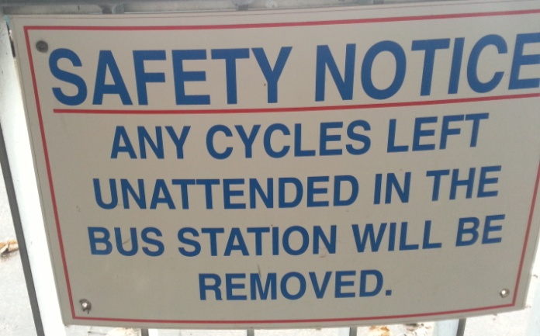
Joined up routes
Needs of families and less experienced cyclists
Easy ‘moving on’
Exe Estuary untapped potential
Link in with public transport
Avoid this! (Exmouth bus station)

